Slide 1

Chapter 5
Abstraction and Interfaces
ITP03 | 1ST SEMESTER

Slide 2
Learning Objectives
Understand the concept and purpose of abstraction in OOP.
Declare and implement abstract classes and methods in PHP.
Define interfaces and implement them in classes.
Differentiate between abstract classes and interfaces.
Apply abstraction and interfaces in real-world scenarios.

Slide 3
What is Abstraction?
Abstraction hides unnecessary details and shows only the essential features.
It focuses on what an object does, not how it does it.
Achieved using abstract classes or interfaces.
Can declared attributes
May contain
-Normal methods (with body)
-Abstract methods (without body, must be implemented in child classes)

Slide 4
Purpose of Abstract Classes
Template for Subclasses
Defines a base structure, leaving details to subclasses.
Enforcing Method Implementation
Child classes must implement abstract methods.
Promotes code consistency across subclasses.

Slide 5
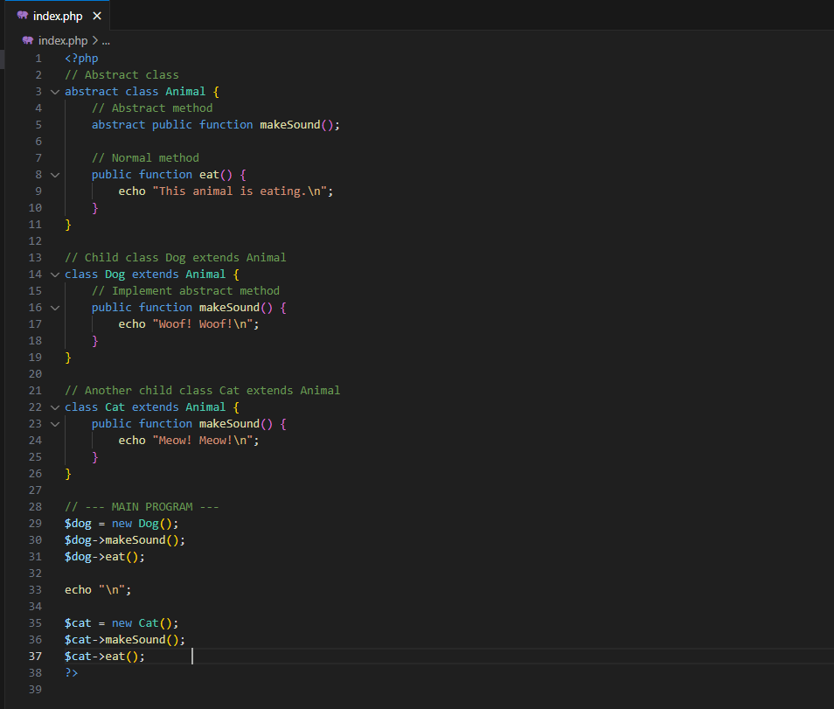
Syntax using Abstract

Slide 6
Purpose of Interfaces Classes
Defined with the interface keyword.
Only contains method signatures (no implementation or body).
A class that implements an interface must provide all methods.
Supports multiple interface implementation (unlike classes).

Slide 7
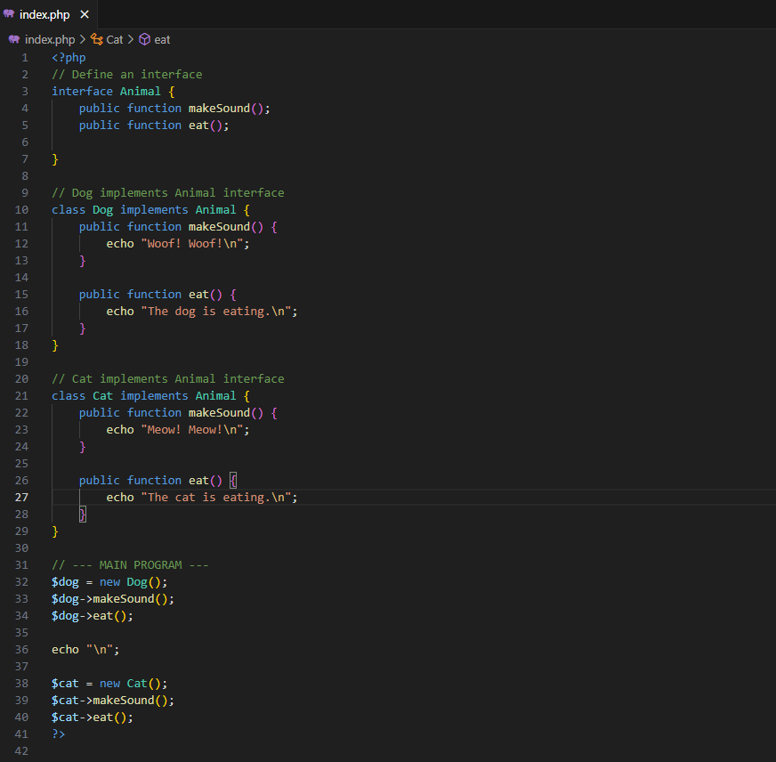
Syntax using Interfaces

Slide 8
Abstract vs Interfaces
Feature | Abstract Class | Interface
Can have method bodies | Yes | No
Can have properties | Yes | No
Purpose | Base class with logic | Strict contract/structure

